Slide 1

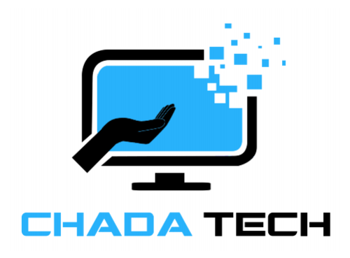
Agile Presentation
By: Vimon Sok

Slide 2



Development Team
Product Owner
Role: Represents the business and stakeholders, ensuring that the development team delivers value to the customer.
Key Responsibilities:
Defines and prioritizes the Product Backlog.
Maximizes the return on investment by guiding the team toward valuable outcomes.
Acts as the voice of the customer, ensuring the team builds the right product.
Collaborates with stakeholders to refine requirements.
Scrum Master
Role: A cross-functional group responsible for delivering the product increment.
Key Responsibilities:
Self-organizing and accountable for completing sprints goals.
Develops, tests, and delivers high-quality software.
Collaborates to refine and estimate backlog items.
Participates actively in Agile ceremonies.
Role: Acts as a servant leader and coach for the Scrum team, ensuring the Agile principles are followed.
Key Responsibilities:
Facilitates Scrum ceremonies (Daily Stand-Up, Sprint Planning, Sprint Review, Retrospective).
Removes obstacles that might hinder the team’s progress.
Coaches the team on Agile best practices.
Protects the team from external distractions.
Notes:
Explaining Agile Roles: Explain the various roles on a Scrum-Agile Team by identifying each role and describing its importance.
“Scrum product owners understand the customer and business requirements, then create and manage the product backlog based on those requirements. (Atlassian, 2025)”
“The scrum master is the role responsible for gluing everything together and ensuring that scrum is being done well. (Atlassian, 2025)”
“The development team includes the people that do the work. (Atlassian, 2025)”
Each role is essential to maintaining an effective Scrum process, ensuring collaboration, efficiency, and continuous improvement.
Reference:
Dave west. Jan 2025. Agile scrum roles and responsibilities. Atlassian.
https://www.atlassian.com/agile/scrum/roles

Slide 3
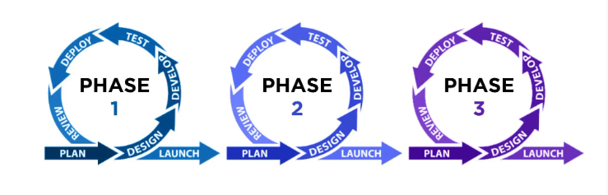
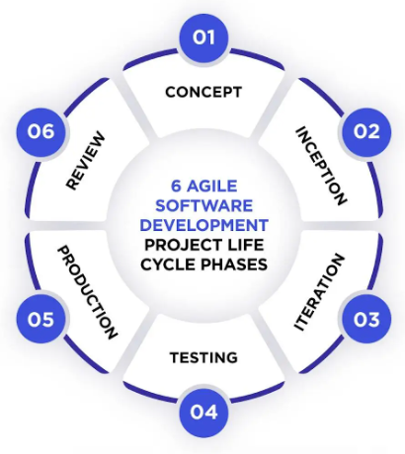
Software Development Life Cycle (SDLC)
(Relevant Software)
Plan
Design
Develop
Test
Deploy
Review
Launch
Sprint cycles, daily standups, continuous improvement.
Collaborative, adaptive teamwork for rapid development.
Iterative, collaborative, adaptive approach to development.
It is Flexibility, collaboration, iterative progress
Plan, prioritize, sprint, review, adapt, collaborate, deliver, repeat.
Efficient collaboration, adaptability, teamwork.
Agile Scrum is Efficiency, collaboration, rapid delivery
Concept | Inception | Iteration | Testing | Production | Review
Identify business needs, goals, and high-level requirements. | “The founder selects the appropriate team members, assigns roles, and provides the necessary tools to begin development. (Rel. Soft, 2024)” | Lays the foundation for a smooth development process, ensures clarity of objectives before coding begins. | Reduces defects and ensure product stability, helps maintain “Done” definition for each increment. | A potentially shippable product increment is reviewed, minimizes risk by releasing smaller updates. | Stakeholders assess the product and provide feedback. The team reflects on what went well and what needs improvement.
(Relevant Software)
Notes:
Explaining Agile Phases: Explain how the various phases of the SDLC work in an Agile approach. Identify each phase and describe its importance.
Agile follows an iterative and incremental approach to software development, breaking down the traditional SDLC into flexible, adaptive phases that emphasize continuous improvement.
SDLC Phase Image (Relevant Software, 2024).
Reference:
Anna Dziuba. Oct 3, 2024. Navigating the Agile Software Development Life Cycle: Phases, Tools, Roadmap. Relevant Software.
https://relevant.software/blog/agile-software-development-lifecycle-phases-explained/

Slide 4
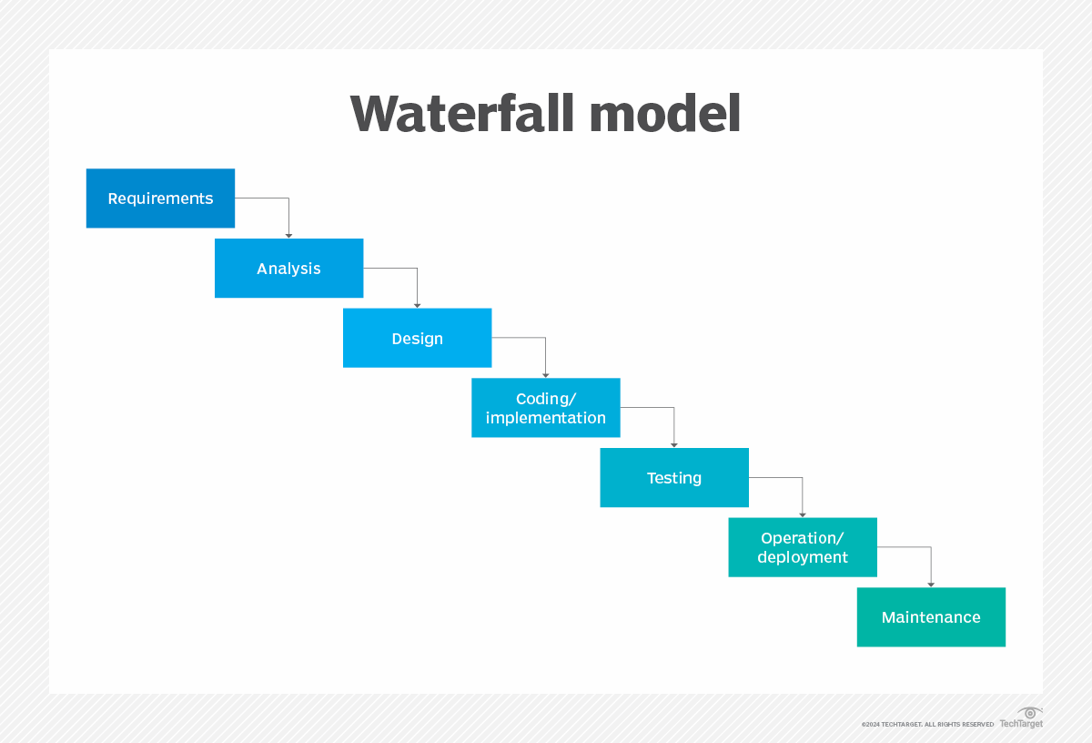
Waterfall Approach:
Planning: All requirements are gathered upfront before any development begins.
Design: The entire system (UI, database, payment, booking) is designed in one phase.
Development: Developers build the entire software without testing or feedback.
Testing: Only after full development is testing done, potentially revealing major issues.
Deployment: The complete software is released at once, with no room for quick fixes.
Problem: If a major issue is found late, fixing it requires redoing earlier phases, causing delays.
Agile Approach:
Sprint 1: Basic travel search feature is developed and tested.
Sprint 2: Booking system is built and integrated with third-party APIs.
Sprint 3: Payment system is tested with real transactions.
Sprint 4: User feedback is collected, and improvements are made.
Ongoing: Continuous updates and fixes based on testing and user needs.
Advantage: Problems are identified early, allowing quick fixes without major rework. Features are delivered faster, making the software adaptable and user-friendly.
Notes:
Describing Waterfall Model: Describe how the process would have been different in a waterfall development approach rather than the Agile approach you used. For instance, you might discuss how a particular problem in development would have proceeded differently.
“The Waterfall model is a linear, sequential approach to the software development lifecycle (SDLC) that's popular in software engineering and product development. (TechTarget, 2024)”
If the SNHU travel software were developed using Waterfall model instead of Agile, the entire development process would have followed a rigid, sequential structure rather than adaptive, iterative approach.
Scenario:
The SNHU travel software includes a hotel booking system, but during development, the team realizes that the third-party database API does not support real-time availability updates.
Waterfall Approach - Going back to fix the problem requires redoing parts of the design and development, leading to significant delays. The release is postponed until a workaround is implemented.
Agile Approach – The hotel booking system is developed in early sprints, with real-tie API testing done upfront. Adjustments are made without delaying the overall project because features are built and tested incrementally.
Reference:
Paul Kirvan. Nov 2024. What is a Waterfall model? Definition and guide. TechTarget.
https://www.techtarget.com/searchsoftwarequality/definition/waterfall-model

Slide 5
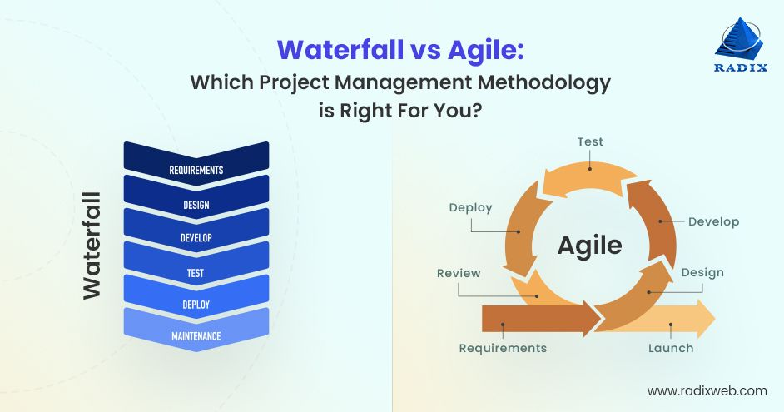
Factor | Waterfall | Agile
Project Scope | Well-defined and unlikely to change. | Evolving requirements and frequent changes
Flexibility | Rigid; difficult to adjust after planning. | Highly adaptable with iterative updates.
Timeline | Long, with single final release. | Short sprints with incremental feature releases.
Testing | Happens at the end of development. | Continuous testing throughout
Stakeholder Involvement | Minimal after planning. | Frequent feedback and collaboration.
Risk Management | High risk if problems are found late. | Lower risk due to early issue detection.
Notes:
Waterfall or Agile Approach: Explain the factors to consider when choosing a waterfall or Agile approach, using your course experience to back up your explanation.
Waterfall is best, if the project is fixed , predictable, and requires extensive documentation. “However, the waterfall model also has a few drawbacks, including its lack of revision opportunities and inflexibility. (Radix, 2023)”
Agile is the better choice, if adaptability, quick releases, and stakeholder collaboration are needed.
Agile is often preferred in modern software development because it reduces risks, improve efficiency, and delivers value faster.
Reference:
Prachi Palkhiwala. Aug 24, 2023. Waterfall vs Agile: What to Know Before Choosing Your Development Method. Radix.
https://radixweb.com/blog/waterfall-vs-agile

Slide 6
References:
Dave west. Jan 2025. Agile scrum roles and responsibilities. Atlassian.
https://www.atlassian.com/agile/scrum/roles
Anna Dziuba. Oct 3, 2024. Navigating the Agile Software Development Life Cycle: Phases, Tools, Roadmap. Relevant Software.
https://relevant.software/blog/agile-software-development-lifecycle-phases-explained/
Paul Kirvan. Nov 2024. What is a Waterfall model? Definition and guide. TechTarget.
https://www.techtarget.com/searchsoftwarequality/definition/waterfall-model
Prachi Palkhiwala. Aug 24, 2023. Waterfall vs Agile: What to Know Before Choosing Your Development Method. Radix.
https://radixweb.com/blog/waterfall-vs-agile
Notes:
Support your work with a minimum of four academic or professional sources published within the last five years (peer-reviewed journals, books, technical reports, government publications, expert industry sites, and so on). All sources used should be cited according to APA style.
References:
Dave west. Jan 2025. Agile scrum roles and responsibilities. Atlassian.
https://www.atlassian.com/agile/scrum/roles
Anna Dziuba. Oct 3, 2024. Navigating the Agile Software Development Life Cycle: Phases, Tools, Roadmap. Relevant Software.
https://relevant.software/blog/agile-software-development-lifecycle-phases-explained/
Paul Kirvan. Nov 2024. What is a Waterfall model? Definition and guide. TechTarget.
https://www.techtarget.com/searchsoftwarequality/definition/waterfall-model
Prachi Palkhiwala. Aug 24, 2023. Waterfall vs Agile: What to Know Before Choosing Your Development Method. Radix.
https://radixweb.com/blog/waterfall-vs-agile

